Slide 1
OMGT1039
Operations Management
Week 9
JIT and Lean Operations

Slide 2
COMMONWEALTH OF AUSTRALIA
Copyright Regulations 1969
WARNING
This material has been reproduced and communicated
to you by or on behalf of Royal Melbourne Institute
of Technology, (RMIT University) pursuant to Part
VB of the Copyright Act 1968 (the Act).
The material in this communication may be subject to
copyright under the Act. Any further reproduction or
communication of this material by you may be the
subject of copyright protection under the Act.
Do not remove this notice.
First page of scanned document
This presentation includes selected slides from
William J Stevenson (2015) Operations Management, 12 ed. ISBN 10: 1259580091, McGraw Hill

Slide 3

Learning Objectives
  Explain what is meant by the term lean operations system
  List each of the goals of a lean system and explain its importance
  List and briefly describe the building blocks of leans system
  List the benefits of a lean system
14-3

Slide 4
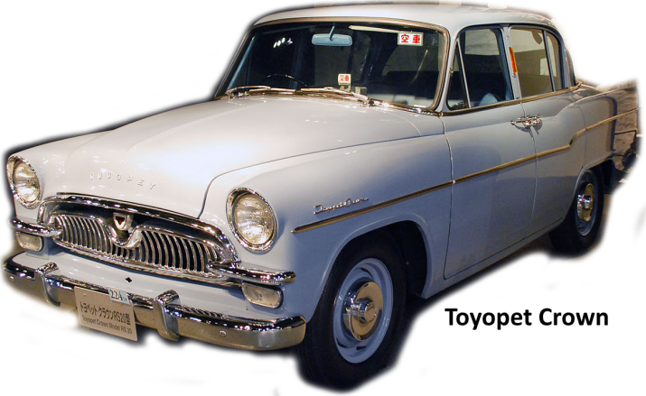
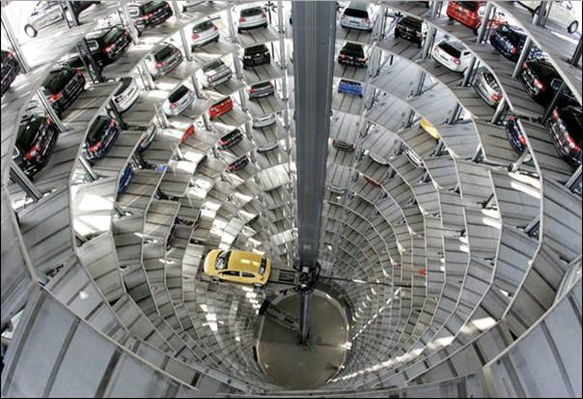
Toyota Motor Corporation
From Toyoda to Toyota
(from power loom to car manufacturer)
Daily 7,000 cars vs 2,700 cars in 13 years
Largest vehicle manufacturer in the world with annual sales of over 9 million vehicles
Success due to techniques, JIT and TPS, and lean Operations

Slide 5

Lean Operations
Lean operation
  A flexible system of operation that uses considerably less resources than a traditional system
    Tend to achieve
      Greater productivity
      Lower costs
      Shorter cycle times
      Higher quality
14-5

Slide 6
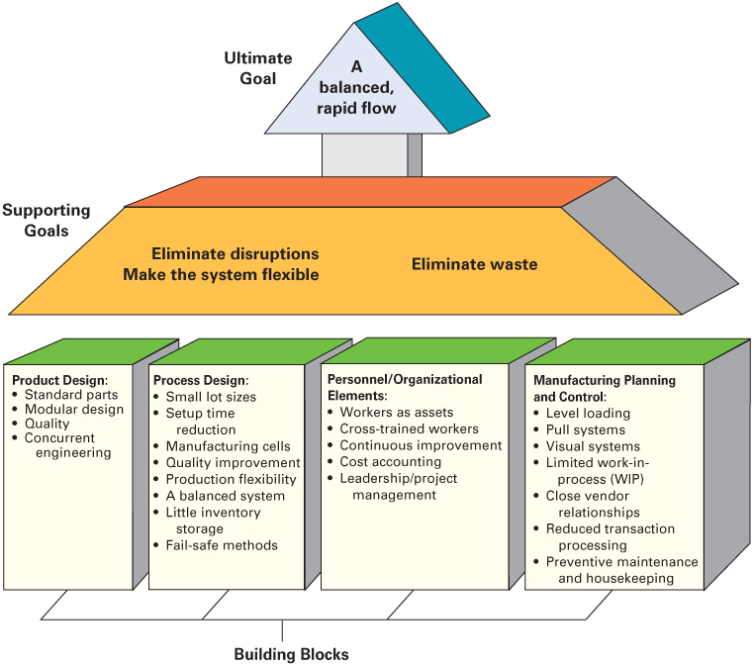
Goals and building blocks of lean systems
14-6

Slide 7

Lean: Ultimate Goal
The ultimate goal:
  Achieve a system that matches supply to customer demand; supply is synchronized to meet customer demand in a smooth uninterrupted flow
  A balanced system
    One that achieves a smooth, rapid flow of materials and/or work through the system
14-7

Slide 8
Lean: Supporting Goals
The degree to which lean’s ultimate goal is achieved depends upon how well its supporting goals are achieved:
  Eliminate disruptions
  Make the system flexible
  Eliminate waste, especially excess inventory
14-8

Slide 9
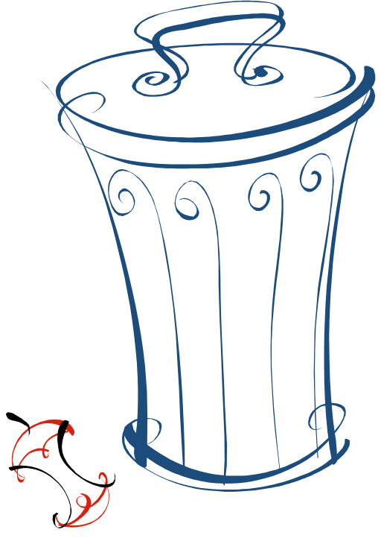
Waste
  Represents unproductive resources
  Seven wastes in Lean philosophy:
    Excess Inventory
    Overproduction
    Waiting time
    Unnecessary transporting
    Processing waste
    Inefficient work methods
    Product defects
14-9

Slide 10

Lean: Building Blocks
Product design
Process design
Personnel/organizational elements
Manufacturing planning and control
14-10

Slide 11

Building Blocks: Product Design
Four elements of product design important for lean systems:
  Standard parts
  Modular design
  Highly capable systems with quality built in
  Concurrent engineering
14-11

Slide 12
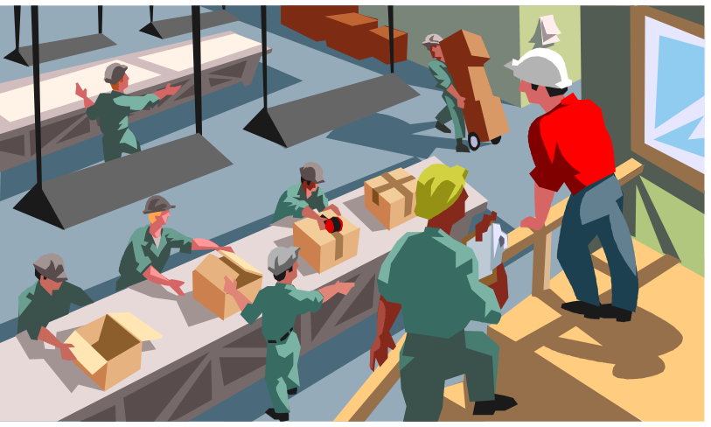
Building Blocks:
Process Design
Eight aspects of process design that are important for lean systems:
  Small lot sizes
  Setup time reduction
  Manufacturing cells
  Quality improvement
  Production flexibility
  A balanced system
  Little inventory storage
  Fail-safe methods
14-12

Slide 13
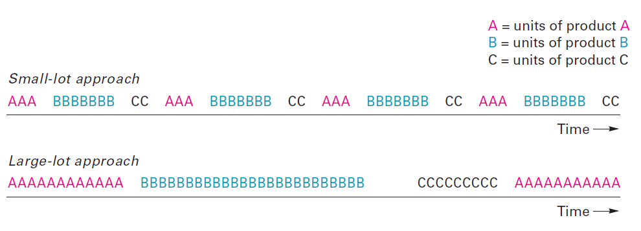
  Building Blocks: Process Design
  Small lot sizes
  Reduced inventory level ➔ Reduced space
  Increased Flexibility
  Increased visibility of problems
Small versus large-lot run sizes
14-13

Slide 14
Process Design: Setup Time Reduction
Small lot sizes and changing product mixes require frequent setups
Unless these are quick and relatively inexpensive, they can be prohibitive
Setup time reduction requires deliberate improvement efforts
  Single-minute exchange of die (SMED)
    A system for reducing changeover time
14-14

Slide 15
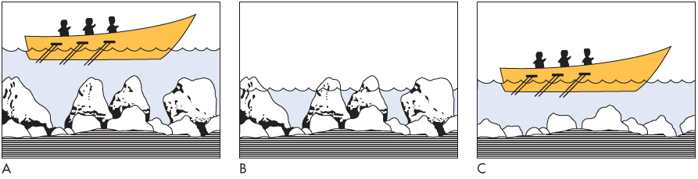
Process Design: Inventory Storage
Lean systems are designed to minimize inventory storage
  Inventories are buffers that tend to cover up recurring problems that are never resolved
    partly because they are not obvious
    partly because the presence of inventory makes them seem less serious
14-15

Slide 16
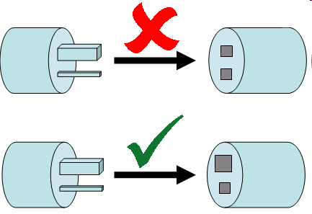

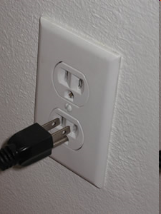

Process Design: Fail-Safe Methods
Poka-yoke (Fail proofing)
  Building safeguards into a process to reduce or eliminate the potential for errors during a process
    Examples
      Electric breakers
      Seatbelt fastener warnings
      ATMs that signal if a card is let in a machine
      Designing parts that can only be assembled in the correct position
14-16

Slide 17

Building Blocks:
Personnel/Organizational
Three important personnel/organizational elements that are important for lean systems:
  Workers as assets
  Cross-trained workers
  Continuous improvement
14-17

Slide 18
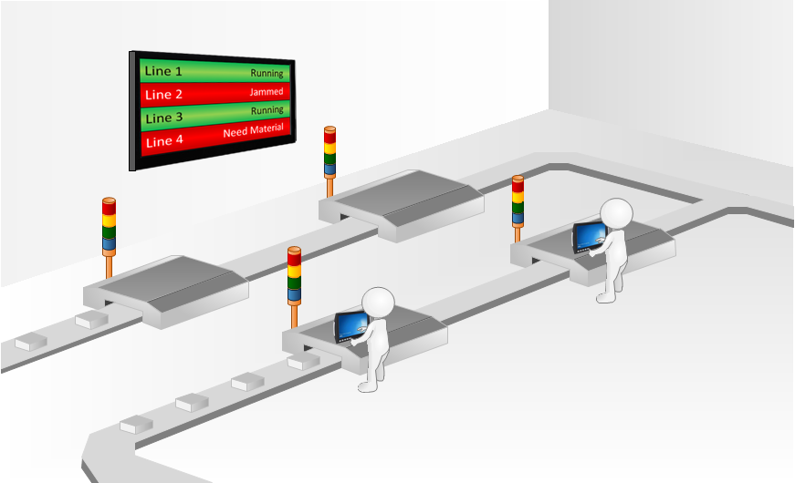
Personnel/Organizational:
Continuous Improvement
Continuous improvement
  Workers in lean systems have greater responsibility for quality, and they are expected to be involved in problem solving and continuous improvement
  Andon: A Light System
  Lean workers receive training in
    Statistical process control
    Quality improvement
    Problem solving
14-18

Slide 19
Building Blocks: MPC
Seven elements of manufacturing planning and control (MPC) are particularly important for lean system:
  Level loading
  Pull systems
  Visual systems
  Limited work-in-process (WIP)
  Close vendor relationships
  Reduced transaction processing
  Preventive maintenance and housekeeping
14-19

Slide 20
MPC: Level Loading
Lean systems place a strong emphasis on achieving stable, level daily mix schedules
  MPS – developed to provide level capacity loading
  Mixed model scheduling
    Three issues need to be resolved
      What is the appropriate product sequence to use?
      How many times should the sequence be repeated daily?
      How many units of each model should be produced in each cycle?
14-20

Slide 21
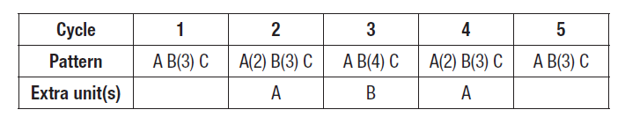
Load Levelling Example
Determine a production plan for these three models using the sequence A-B-C:
Model | Daily Quantity
A | 7
B | 16
C | 5
Solution

Slide 22
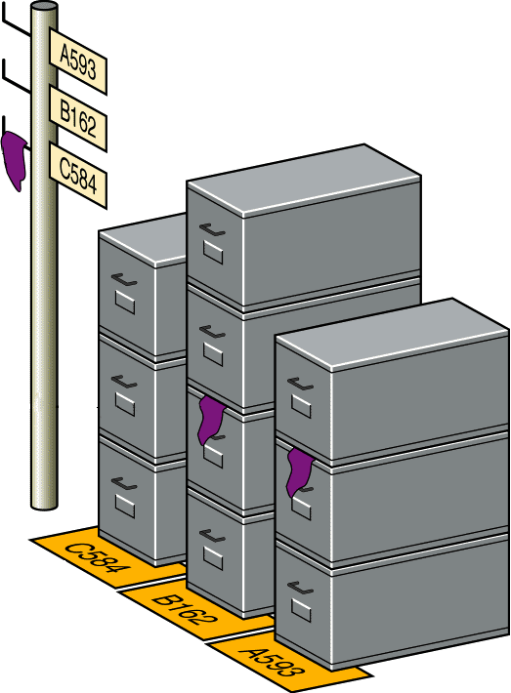
MPC: Visual Systems
Kanban
  Card or other device that communicates
  demand for work or materials from the
  preceding station
    Kanban is the Japanese word meaning “signal”
    or “visible record”
  Paperless production control system
  Authority to pull, or produce, comes
  from a downstream process.
  Two main types of kanbans:
    Production kanban (p-kanban): signals the need to produce parts
    Conveyance kanban (c-kanban): signals the need to deliver parts to the next work center.
Source: Operations Management (2011) Jay Heizer and Barry Render 10e Global edition, Pearson
14-22

Slide 23
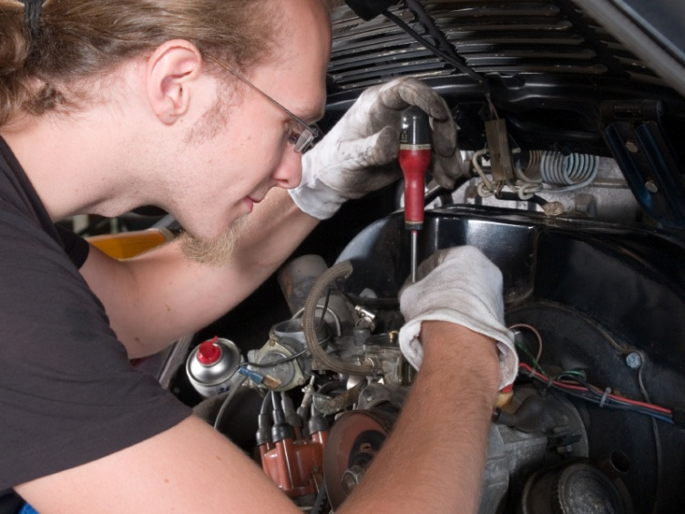
Preventive Maintenance and Housekeeping
Preventive maintenance
  Maintaining equipment in good operating condition and replacing parts that have a tendency to fail before they actually do fail
Housekeeping
  Maintaining a workplace that is clean and free of unnecessary materials
  5s Housekeeping:
    1. Sort
    2. Straighten
    3. Sweep
    4. Standardize
    5. Self-discipline
14-23

Slide 24
Lean vs. Traditional Philosophies
Factor | Traditional | Lean
Inventory | Much to offset forecast errors, late deliveries | Minimal necessary to operate
Deliveries | Few, large | Many, small
Lot sizes | Large | Small
Setup; runs | Few, long runs | Many, short runs
Vendors | Long-term relationships are unusual | Partners
Workers | Necessary to do the work | Assets
14-24

Slide 25
Questions
14-25

